Slide 1
SHUTL
Created by Group 12

Slide 2
Brief Layout
Instead of the typical flat layout of the map we flipped it on its head and turned it upside down. Our layout is 5 floors – Ground Floor, Floor 1, Floor 2, Floor 3 and the Roof.
There are staircases to the right of the building and a fire escape to the left.
There is a helicopter on the roof waiting to take you away with an injured pilot in there.
There is a main door at the bottom that will give you access to the outside world and your freedom.
There will be obstacles such fire and smoke that will hurt your health. For example if you enter the fire filled staircase, you will lose 50 hp
Furthermore you will lose health every time you move up or down.

Slide 3
Items
There are various different items in the game which will aid you within the game. These are…
Brick
Rope
Chocolate (Dairy Milk for Joe)
ID Card
Key
First Aid Kit
Fuel
Some of these will be very useful to your escape, but only if used in the correct place and the correct order

Slide 4
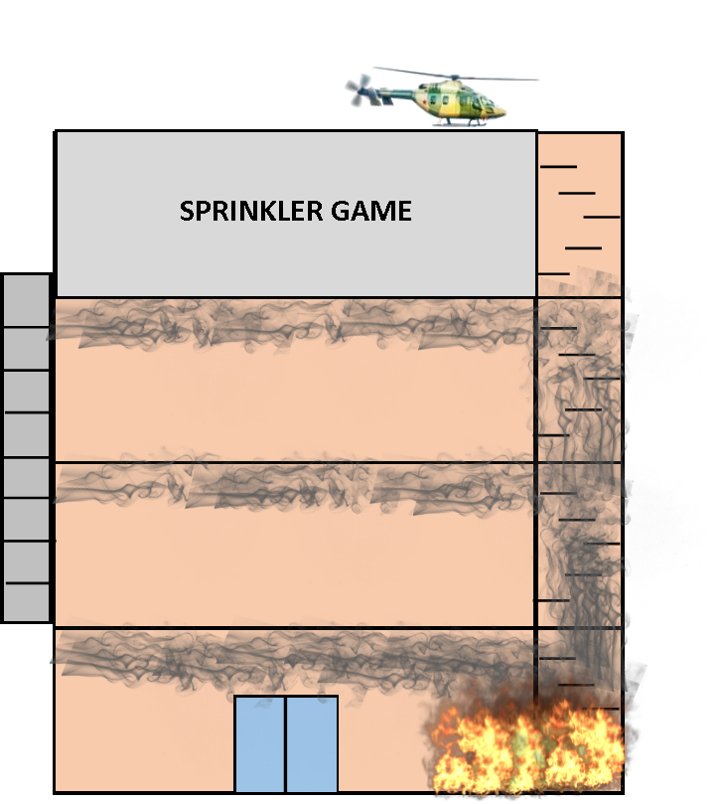
Visual Map

Slide 5
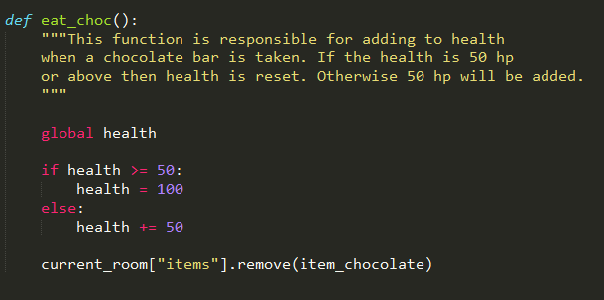
def eat_choc():

Slide 6
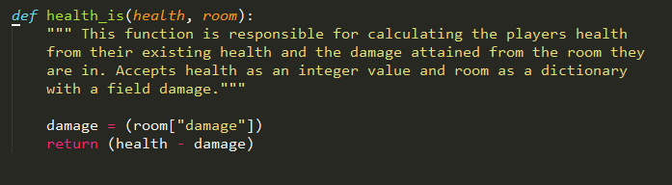
def health_is(health, room):

Slide 7
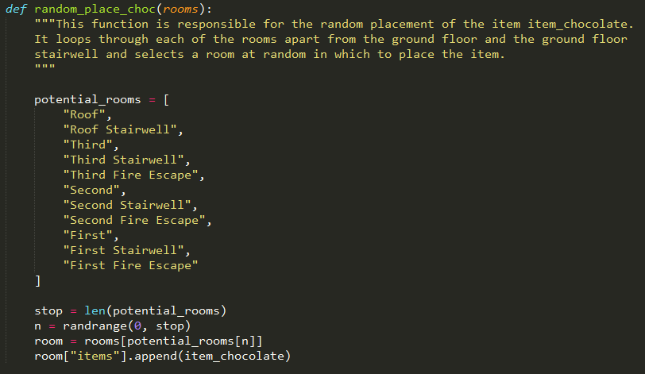
def random_place_choc(rooms):

Slide 8
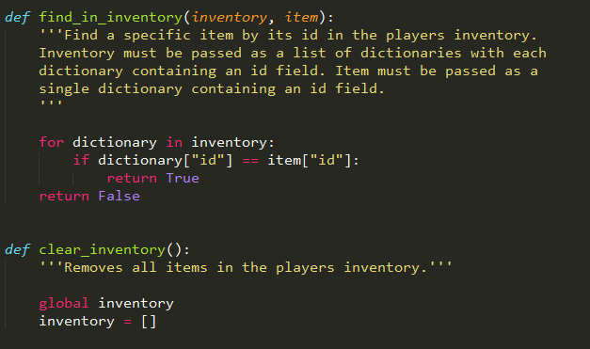
Inventory Functions

Slide 9
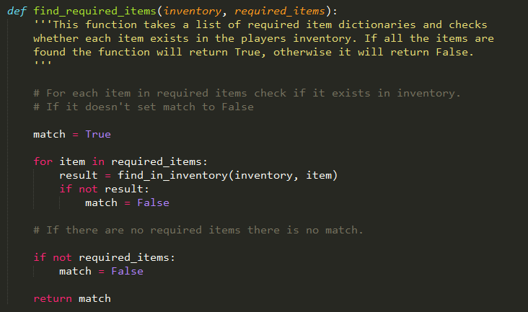
def find_required_items(inventory, required_items):

Slide 10
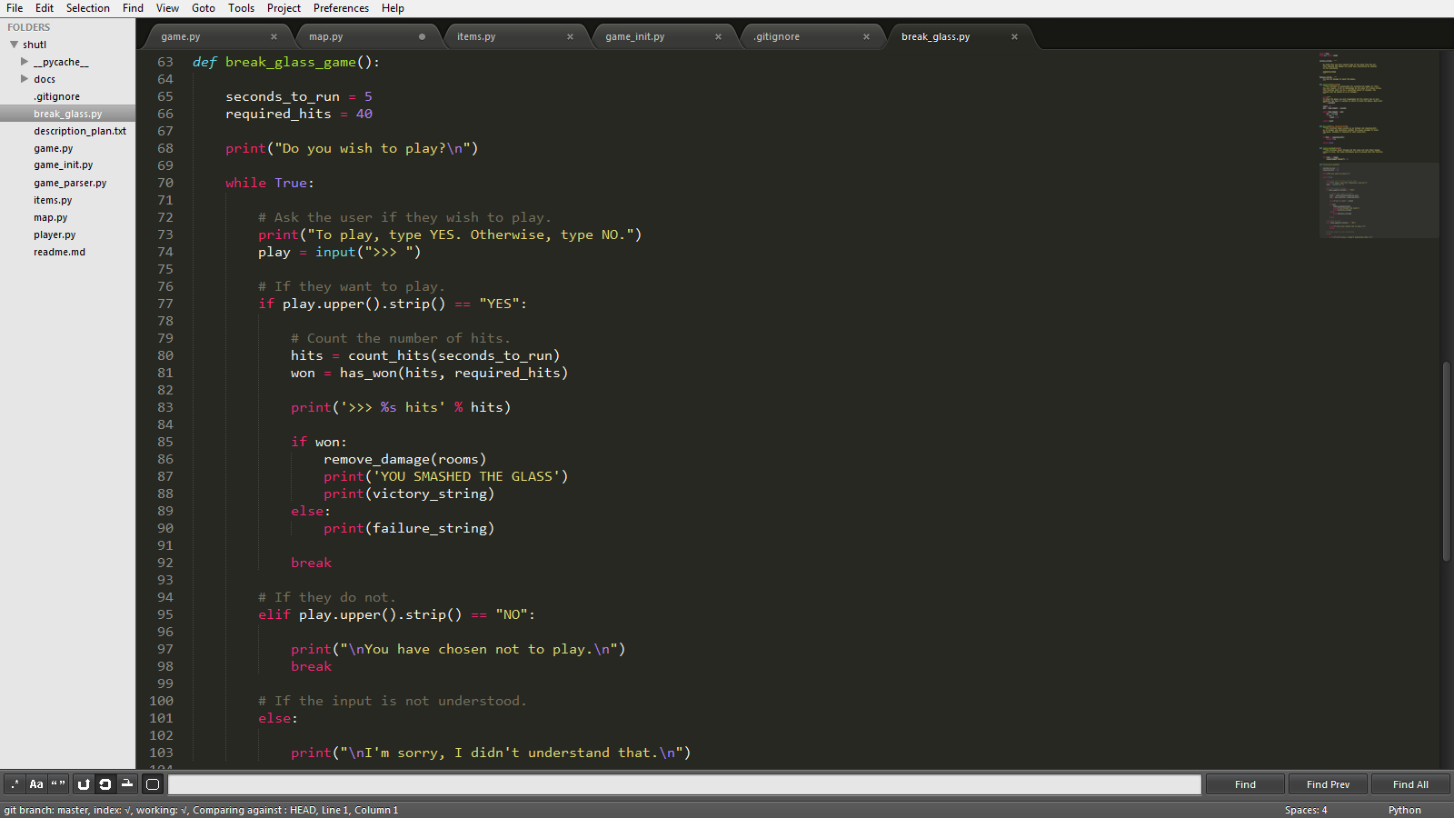
Third Floor Game

Slide 11
Hope you enjoy the game!
Hope you enjoy the game!
By the way, there is a much easier way to escape from the building, you Should Have Used The Lift
SHUTL

